Slide 1
Principal Component Analysis
PRESENTER : Bibash Acharya ( 022409-17)

Slide 2
Contents
Introduction
Objectives
Background and Motivation
Implementation and Mechanism
Conclusion

Slide 3
Introduction : Principal Component Analysis in Image Processing
PCA, a Dimensionality Reduction Technique for image data by conserving the critical features
Key features : Eigen Faces, Eigen Values, Eigen Vectors
Applications in Machine Learning, Image Processing and Computer Vision

Slide 4
Objectives
To apply the PCA mechanism to reduce the dimensions of Image Data by also retaining the significant features
To Achieve Computational Efficiency
To Improve the Effectiveness of Classification and Recognition Algorithms

Slide 5
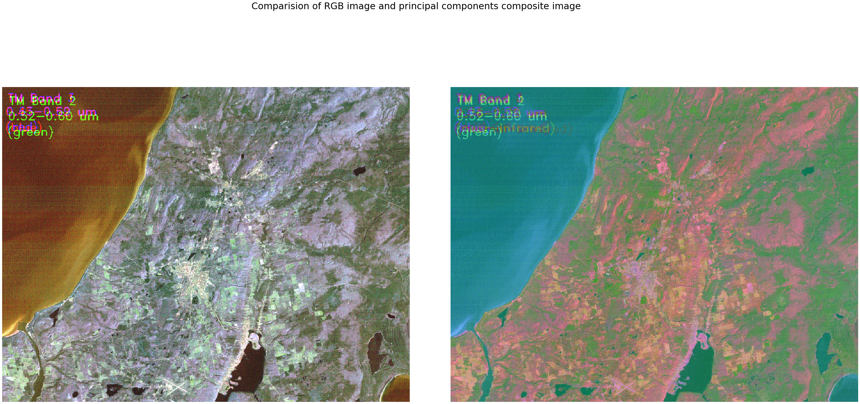
Background and Motivation
Face Recogniton using PCA ( Code Heroku, 2019)
PCA testing on Image Data ( Kumar,2020)

Slide 6
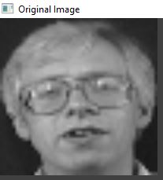
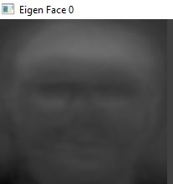
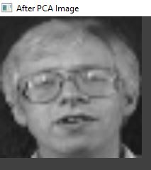
Implementation and Mechanism
Eigen Values Computation
ORL Dataset

Slide 7
Conclusion
Limitations:
Only for Image Files
Accuracy of ORL Data Set (93% Approx.)
Enhancement:
To work on Video Files
To Work on Large Data Sets

Slide 8

Thank You

